Slide 1
MRv1 and MRv2
Differences and Failure modes

Slide 2
Intro.
Configuration properties and their values
Configuration Property | Value | Mode
mapred.job.tracker | local | Local job runner is used in which whole job is in a single JVM. This mode is used for testing map-reduce programs .
 | Colon separated host and port pair | This is the job tracker address for running in real environments .
mapreduce.framework.name | classic | Local job runner
 | local | MapReduce 1
 | yarn | Yarn framework

Slide 3
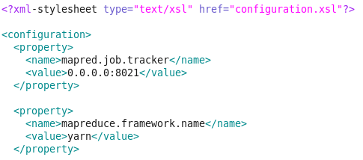
Configuration parameters
Path: /usr/lib/hadoop-0.20-mapreduce/conf/mapred-site.xml

Slide 4
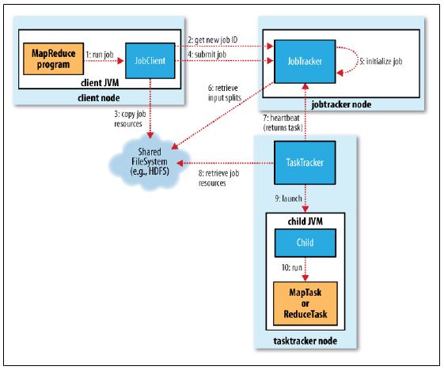
MRv1
It has 4 important components.
The Client
The Job Tracker
The Task Tracker
A Distributed File System HDFS

Slide 5
MRv2
YARN meets the scalability shortcomings of “classic” MapReduce by splitting the responsibilities of the jobtracker into separate entities.
Yarn has 5 important concepts:
The Client.
Resource manager
Node Managers
MapReduce application master
HDFS

Slide 6
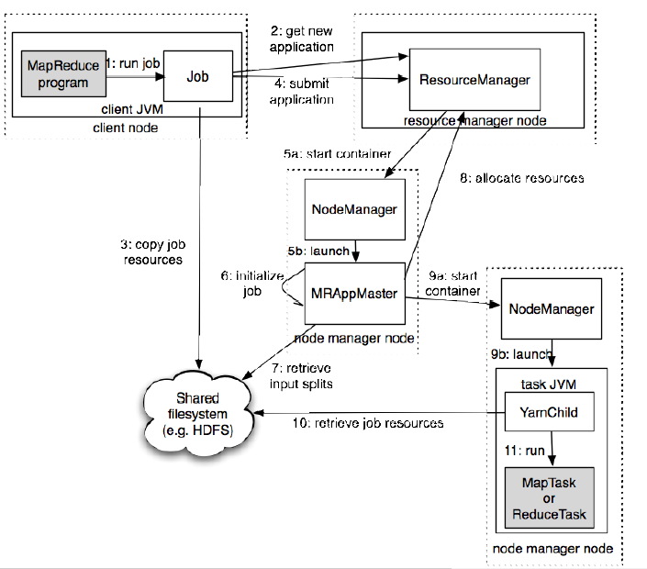
Map reduce job with YARN
Source: Hadoop_the_definitive_guide

Slide 7
Functioning difference
In Mapreduce 1 jobtracker used to launch tasktrackers to run the jobs and also keep a track of progress by each task tracker.
In Mapreduce 2 (yarn) , this dual functioning of jobtracker is split.
There is a resource manager which allocates resouces for each a job. On receiving the job, its scheduler launches containers with appropriate resources (memory)
These containers have “node managers” which launch and manage compute containers foreach task.
The “application master” coordinates various tasks. If tasks cannot be performed on its own container, it requests resources from resource manager and launces new containers with their own node managers on it.
Thus from previous version, Job tracker has been replaced by resource manager and application master.
Tasktracker has been replaced by node managers.

Slide 8
Failures:
In MRv1:
Task Failure
Task Tracker Failure
Job Tracker Failure ( single point of failure )
In MRv2: (YARN)
Task Failure
Application master Failure
Node Manager Failure
Resource manager Failure
Once resource manager fails, new resource manager with saved state is started.Since resource manager does not maintains tasks, it is more safe than MRv1.

Slide 9
Failures in MRv1
If a task on particular takstracker fails, the task tracker will stop it freeing up its slots and notify to jobtracker. The jobtracker will avoid scheduling the task to same tasktracker. If a particular task if failed 4 times, (default) the whole job fails.
Properties :
mapred.map.max.attempts , mapred.reduce.max.attempts
To prevent a job from failing even after failure of few map/reduce tasks, properties are:
mapred.max.map.failures.percent, mapred.max.reduce.failures.percent
If a task tracker fails, its removed from jobtracker’s list of task trackers and tasks on it will be rerun on different task trackers.
If job tracker fails , then the whole job fails since it keeps track of both allocating tasks and maintaining their progress. This is its ‘Single point of failure’.

Slide 10
Failures in MRv2
All tasks are reported to application master. This is similar to task failure in MRv1.
Properties :
mapreduce.map.maxattempts, mapreduce.reduce.maxattempts
mapreduce.map.failures.maxpercent, mapreduce.reduce.failures.maxpercent
If application master fails, resource manager will launch new application master in a new container. Application master sends periodic heartbeats to resource manager.
If node manager fails , resource manager will remove it from its available list of node managers. Status of tasks/application master running on it can be recovered
Resource manager failure: If a resource manager fails, a new resource manager is initiated by an administrator from a previous saved state which consists of all node managers and its running applications. Independence of task running for resource manager prevents dingle point of failures.

Slide 11
EduPristine 702, Raaj Chambers, Old Nagardas Road, Andheri (E), Mumbai-400 069. INDIA www.edupristine.com Ph. +91 22 3215 6191

